Slide 1
Institute for Development, Evaluation, Assistance and Solutions
Instituto para el Desarrollo, Evaluación, Asesoría y Soluciones

Slide 2
What is IDEAS?
A Georgia non-profit
Has worked in community economic development in 4 different continents
for 35 years.
Assists national organizations in
microfinance,
microenterprise development &
microfranchising.

Slide 3
A new project,
TecAp,
provides solar and other appropriate technologies to rural Nicaragua.

Slide 4
What is TecAp?
Provides appropriate technologies to coffee producers in fair trade cooperatives in Nicaragua.
Methods:
Train rural women to
Sell small technologies
Promote solar energy in her community
Assist with financing
Helps coops get longer term international financing
Coops then provide microcredit to extend the loan term to lower the annual amount so low income families can buy technology

Slide 5
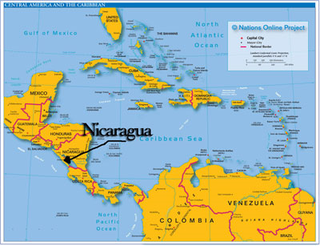
Where TecAp is working?
Starting in Nicaragua, the second poorest country in the Americas.
The 4 hour flight from Atlanta is less than the time to fly to San Francisco.
Nicaragua is just 1500 miles away from Atlanta.
Nicaraguans are practically
our neighbors…
…Yet one-third live without
electricity.

Slide 6
Why solar energy? Isn’t it a luxury?
One third of the world’s population does not have electricity.
Half could obtain solar panels at local market rates if financing was long term or it was rented.

Slide 7
TecAp helps families buy solar panels over a 5 year period.
The panels are guaranteed for 25 years.

Slide 8
Do you think the electric company is likely to install lines to serve this one family?

Slide 9
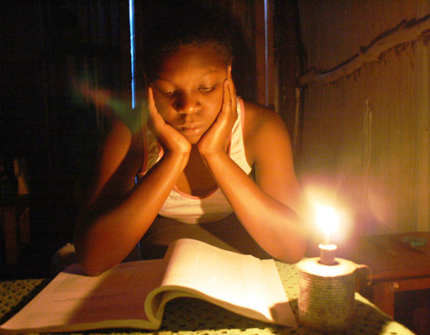
Disadvantages of Kerosene Lights
Pollute the home
Blacken clothes and lungs
Great danger of fire

Slide 10
How does solar assist the poor?
Benefits the family
No fumes from kerosene lanterns
Enables night studying
Saves money
No batteries for flashlights or kerosene
Helps women generate money in microenterprises in their homes
Businesses in home can stay open later
Electricity attracts neighbors without electricity to the home-based stores

Slide 11
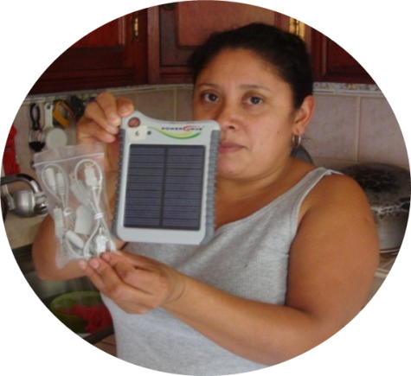
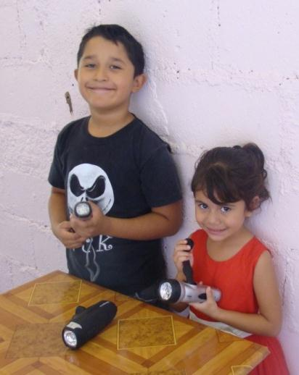
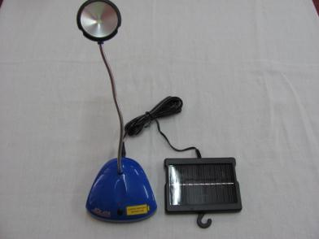
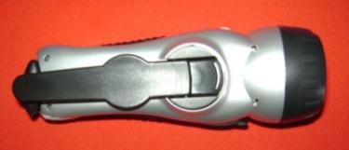
Women are being trained to be promoters of the new technologies
Start by selling small solar powered items.
Flashlights are either
solar powered or hand cranked
Gooseneck lamp runs on solar panel.
Even children learn how useful solar power is

Slide 12
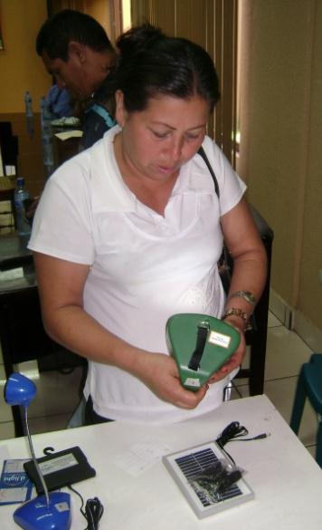
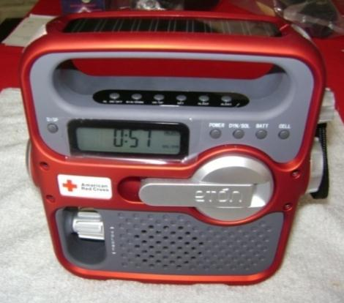
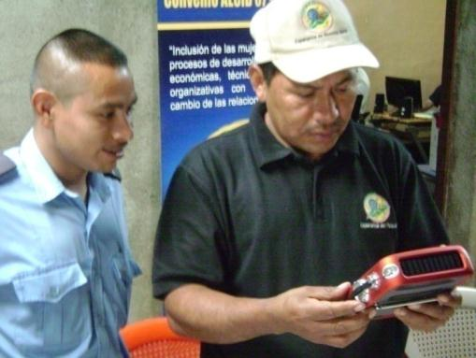
Solar powered radio:
now sold at Radio Shack
Women earn income as they sell to their neighbors and educate about solar power & other energy alternatives.

Slide 13
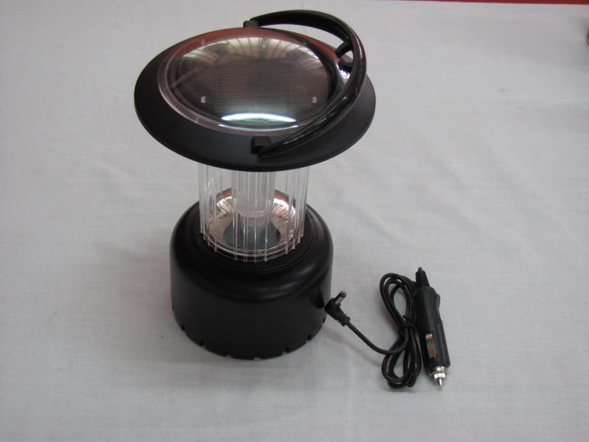
Solar lanterns help in emergencies
TecAp provided solar powered lanterns to 44 families that were living in temporary shelters
Families had to move from their homes due an earthquake tremor.
They were members of a coffee coop that reached out to TecAp to assist with solar because it was far from electric lines.

Slide 14
TecAp is successful
In 2010, UCPCO (an organic coffee cooperative) made long term loans to 50 of their members.
50 systems were installed on rooftops in July 2010.
The loans allowed low-income farmers to afford solar panels.
For the first time, these 50 farm families now have electricity in their homes.

Slide 15
How did it happen?
Throughout 2010:
IDEAS worked with Root Capital to consider coffee coops’ request for 3-5 year loans
TecAp convinced UCPCO coop board of the need for solar energy
Developed interview questionnaire
Oriented promoters
Tabulated results of interviews
RC lent $22,000 for 3 years to UCPCO, who then lent to the families who were members of the coop

Slide 16
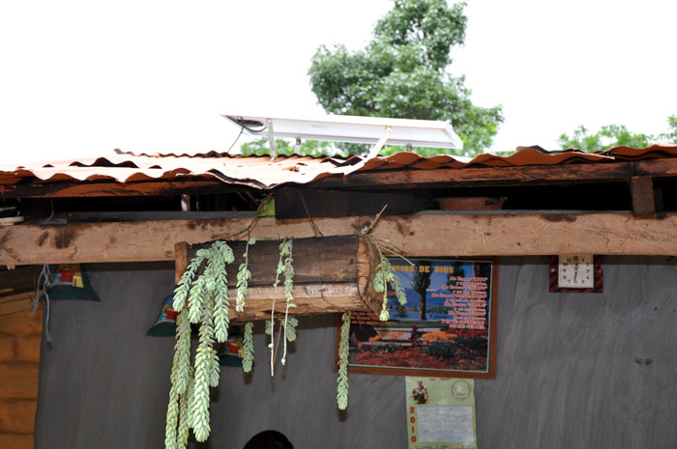
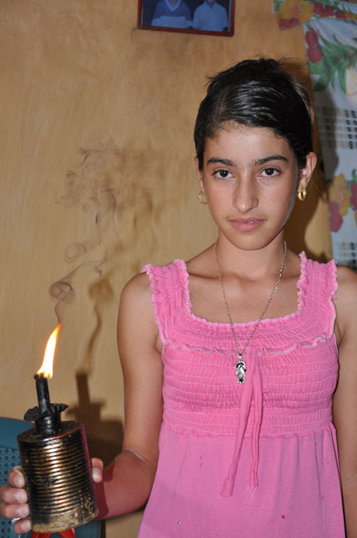
One 15 year old gave up her Quinceañera party so that her parents could buy a solar system.
She wanted to give she and her mom the ability to study by electricity to avoid the polluting fumes of the kerosene lantern.

Slide 17
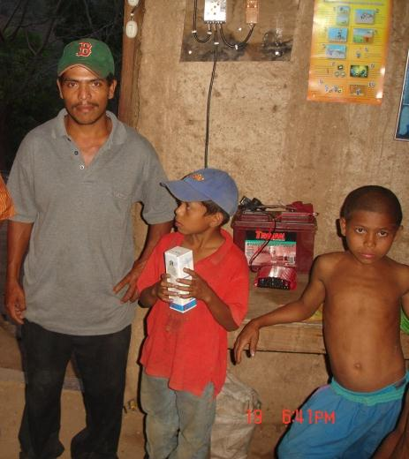
Isidro Antonio González The 20 de Abril Services Cooperative, R.L
Cooperative member since 2003
Latest loan was approximately $610 – used to purchase a 50 watt solar panel to improve his family’s quality of life

Slide 18
Isidro Antonio González The 20 de Abril Services Cooperative, R.L
With the support of the coop, he has been able to improve his
home,
agricultural production,
and
family’s standard of living

Slide 19
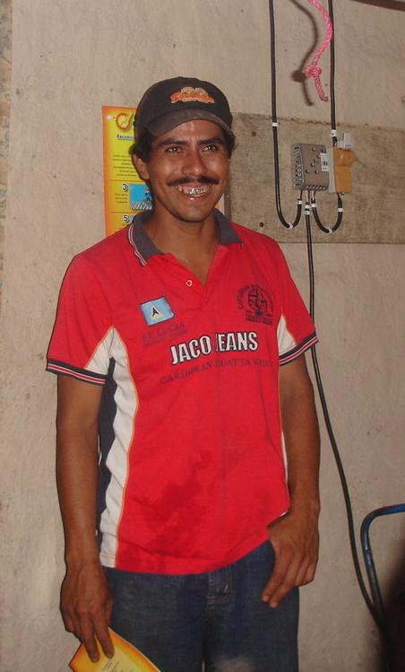
Santiago Herrera Troche The 20 de Abril Services Cooperative, R.L
Member of coop since 2003: has received 19 loans
Loans help increase Santiago’s working capital and improve his family’s life

Slide 20
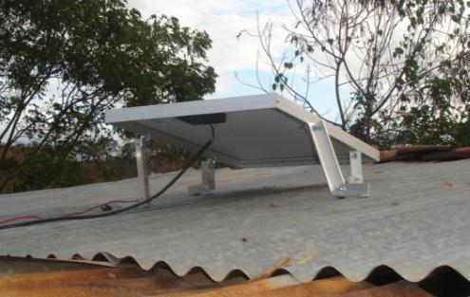
Santiago Herrera Troche The 20 de Abril Services Cooperative, R.L
“"My house is better; I’ve plastered it, improved the ceiling, and I even have electricity with the solar panel loan they gave me at the cooperative. I never thought that my house would have light and we could watch TV.“
-Santiago
Santiago's dream is that his children follow in his footsteps in associating themselves with the cooperative, saving, and working hard so that they have something to fall back on.

Slide 21
More Projects…
TecAP assisted PRODECOOP to receive and tabulate applications for 99 systems
A smaller coop is looking to work with PRODECOOP to provide 40 members with solar electricity

Slide 22
TecAp now working on…
Building relationships with other lenders to get more lenders for solar panels
Seeking donations to recruit and train local women to promote solar energy in communities

Slide 23
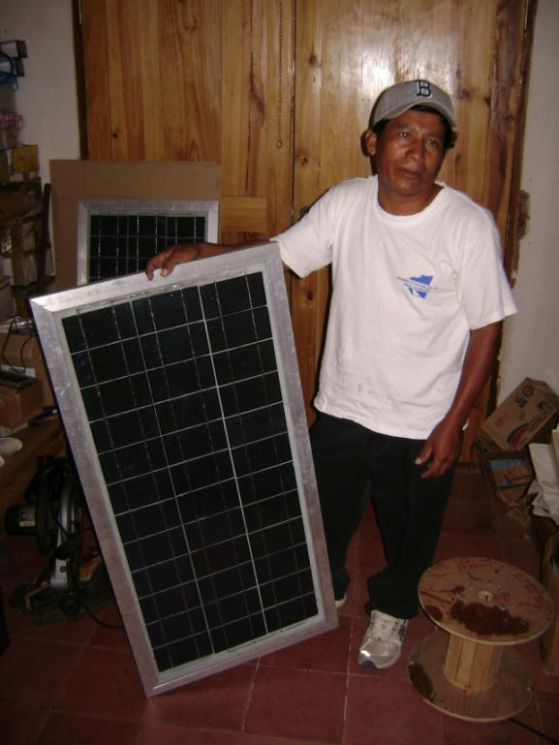
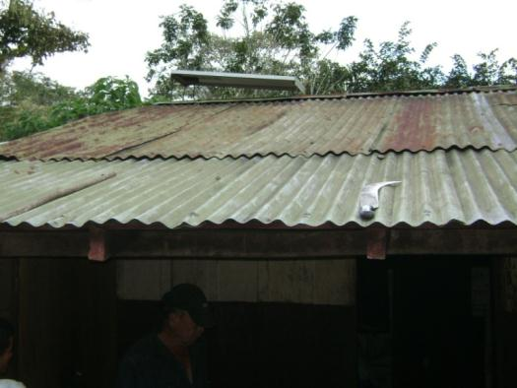
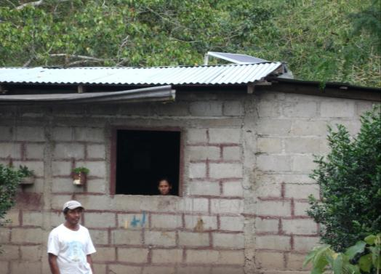
Solar Panels installed on Rural Homes

Slide 24
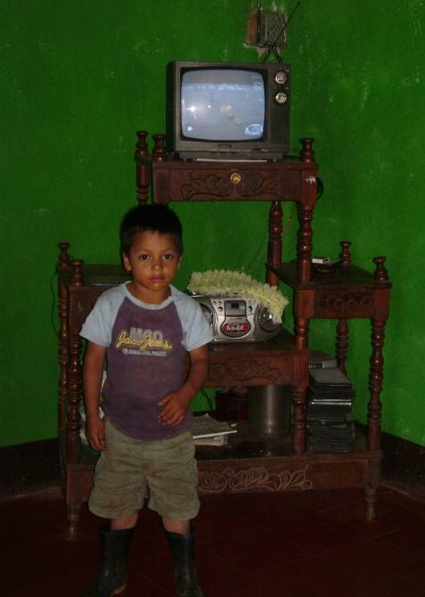
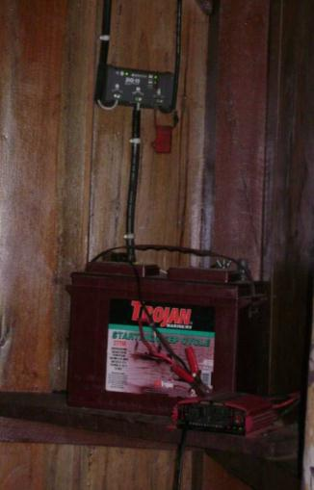
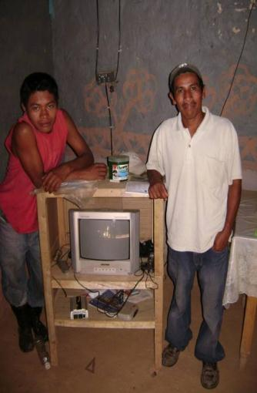
Small photovoltaic system for a house of 85 watts costs about $1000.
Provides energy for light bulbs, TV, sound system, charging cell phones, etc.
System consists of solar panel(s), controller, batteries
and an inverter to change DC to AC.

Slide 25
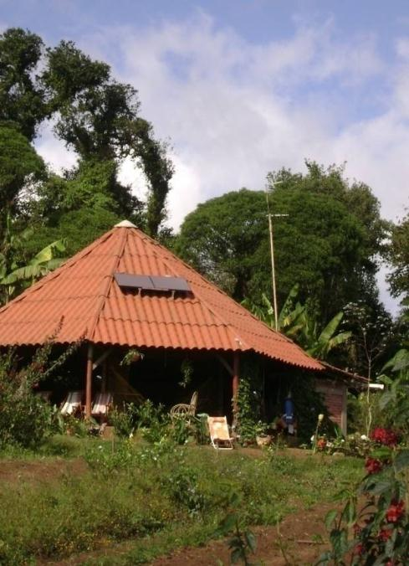
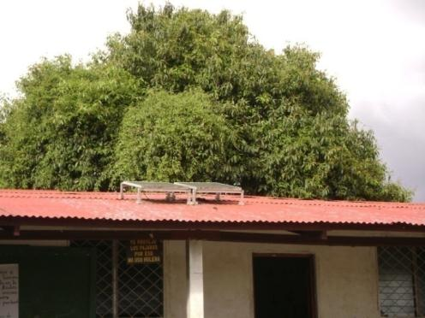
Community Buildings schools, offices, etc.
Ecotourism lounge

Slide 26
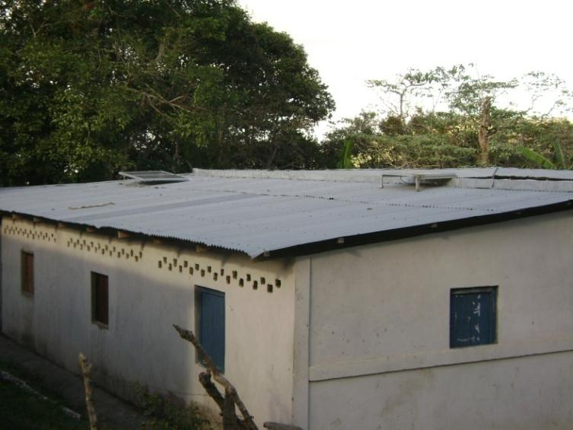
Clinics Keep Vaccinations Cool
Clinic uses 2 panels –
Panel 1: Fridge
Panel 2: Office computer, printer, fans, etc.
Small refrigerator for vaccination medicines

Slide 27
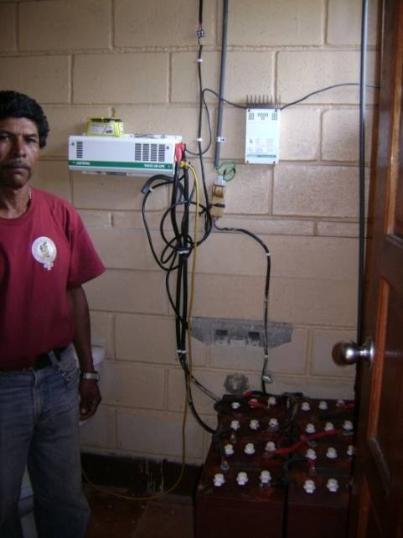
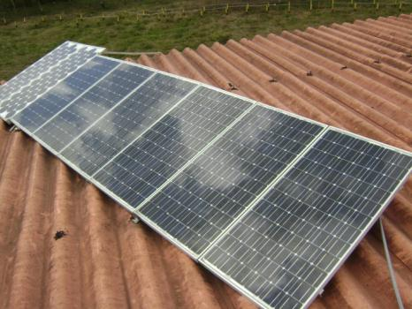
Community Radio Station
Panels on top of radio station
Radio studio with computer, fan, etc.
Batteries store DC power and inverter converts to AC power

Slide 28
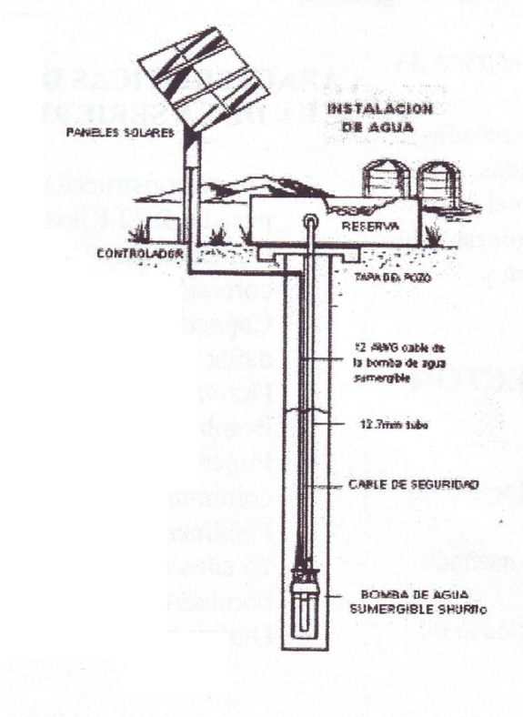
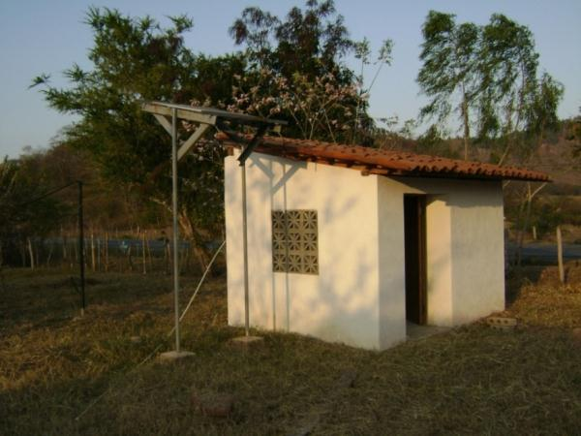
Water Pumping
Solar energy pumps water for homes, animals or irrigation.

Slide 29
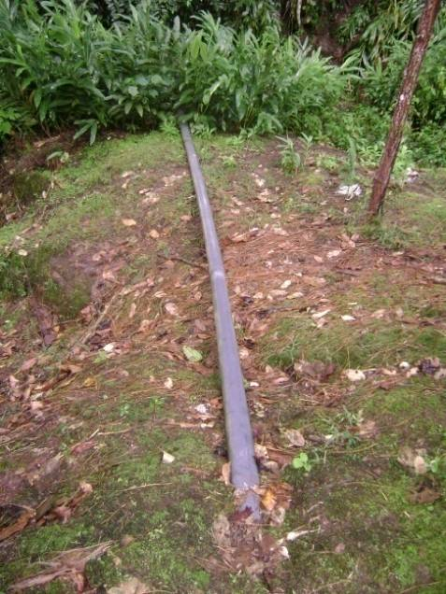
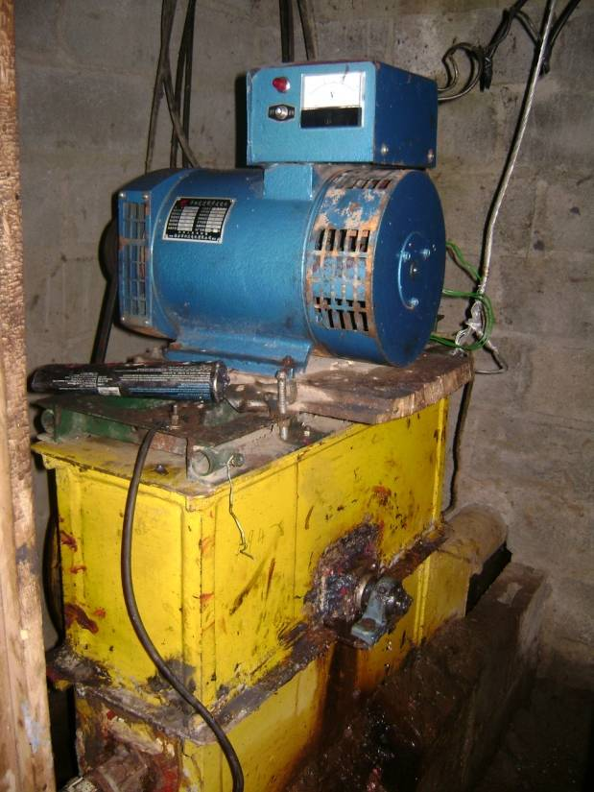
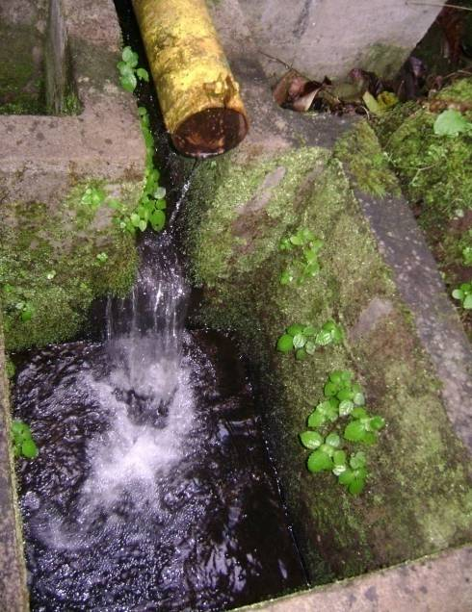
Water Pumping (cont…)
Water coming in
Hydroelectric System
Water returning to stream
29

Slide 30
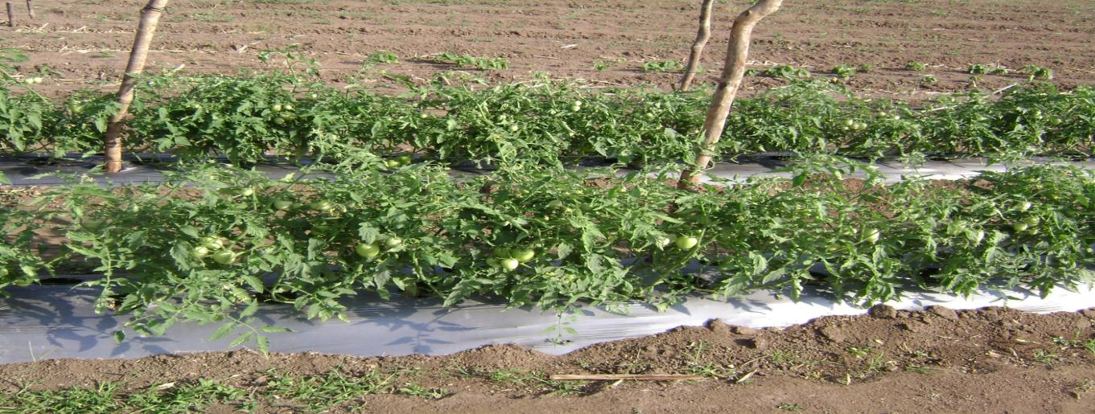
Drip Irrigation
Solar pumps can be connected to drip irrigation that conserves
water.

Slide 31
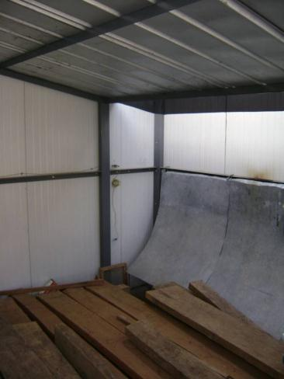
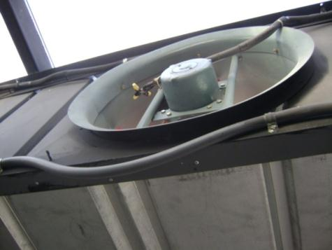
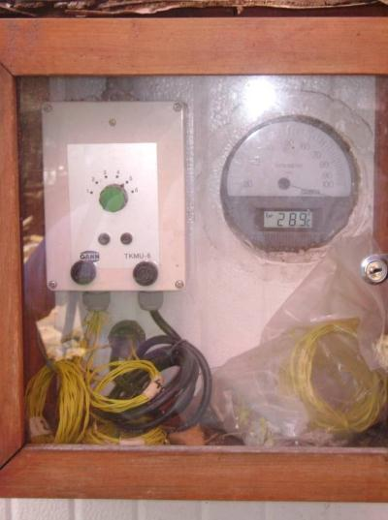
Solar powered wood dryer makes furniture

