Slide 1
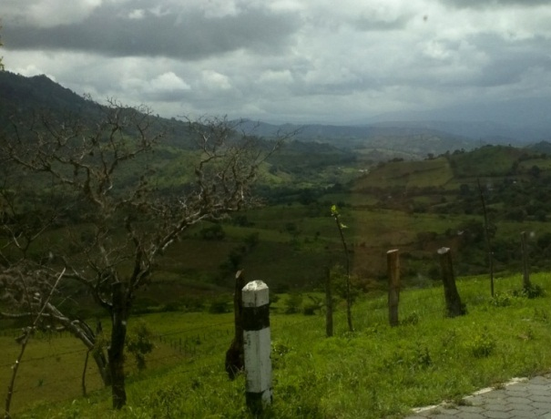
IDEAS has created the 1st microfranchise in Nicaragua
TECAP stands for “technology that is appropriate.” TECAP provides appropriate technologies to rural people.
We have begun with farmers
producing in fair trade coffee
cooperatives in Nicaragua.

Slide 2
How does TecAp work?
Trains very low-income rural women to be microfranchisees to:
Sell small articles like solar powered lights & radios
Take orders for larger systems like solar panels on the rooftop.
Promote solar energy and other technologies within their communities

Slide 3
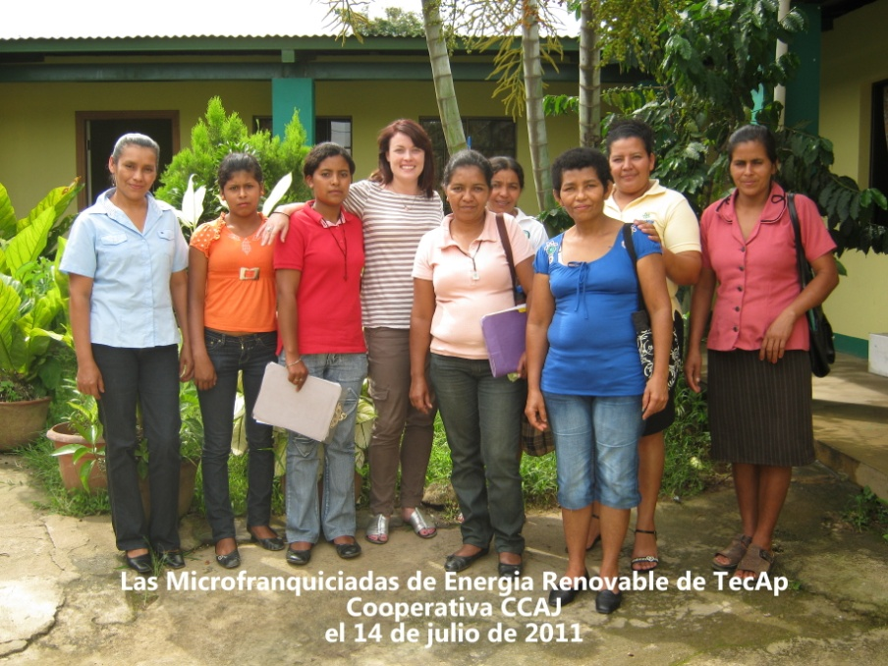
Who are the TecAp microfranchisees?
Coop members, wives of coop members, or daughters of coop members
They range in age from 19-60 years old
The pilot group consisted of 8 women from CCAJ, a coffee cooperative in
northern Nicaragua,
very close to the
Honduras border
20 microfranchisees are selling to neighbors in
remote, rural
northern Nicaragua!

Slide 4
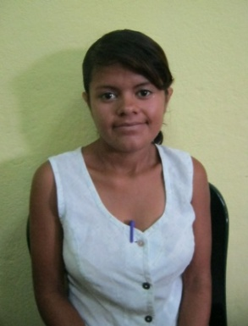
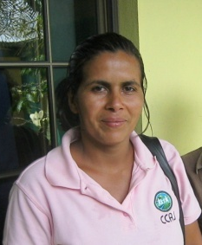
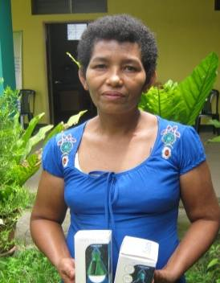
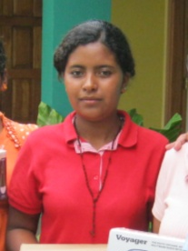
Who are the TecAp microfranchisees?
Janellis Sarai Castro Herrera
Las Neblinas
Jalapa, Nueva Segovia
Daughter of Coop Member
Housekeeper, Finishing high school by taking night classes
Blanca Rosa
Montenegro Martínez
San Antonio de Tauquil
Jalapa, Nueva Segovia
Coop Member
Homemaker, assists with all aspects of production on her farm
Natalia Garrido López
Las Pampas
Jalapa, Nueva Segovia
Wife of Coop Member
Homemaker, assists with all aspects of coffee production, and manages the finances for the family farm
Iris Yesenia Garmendia Rodríguez
(Migdalia Rodríguez’s daughter)
La Providencia
Jalapa, Nueva Segovia
Daughter of Coop Member
Sells clothing, assists with harvesting coffee on the family’s farm

Slide 5
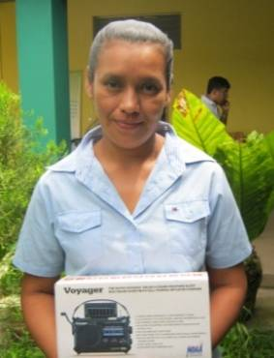
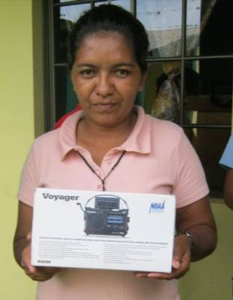
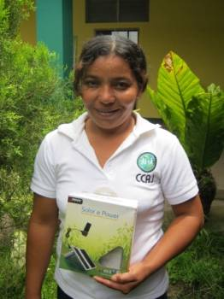
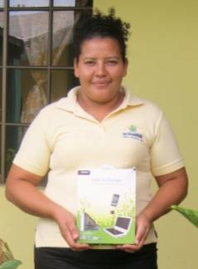
Who are the TecAp microfranchisees?
Trinidad Alfaro
Santa Rosa
Jalapa, Nueva Segovia
Wife of Coop Member
Homemaker, Beekeeper, assists in various aspects of coffee production on the family’s farm
Migdalia del Carmen Rodríguez Herrera
La Providencia
Jalapa, Nueva Segovia
Wife of Coop Member
Homemaker, sells clothing, assists with all aspects of coffee production on the family’s farm
Marta Lorena
Montiel Ortez
Las Uvas
Jalapa, Nueva Segovia
Coop Member
Homemaker and farm owner
Johana Martínez Hernández
Campo Hermoso
Jalapa, Nueva Segovia
Coop Member
Single mother, Farm owner, sells various products including cosmetics and clothing

Slide 6
What do microfranchisees do?
Microfranchisees go door to door with samples and a catalog. Usually in areas off the grid.
The customer places an order.
The microfranchise, TecAp, fills the order.
Then the microfranchisee returns to the customer with the item and receives cash.

Slide 7
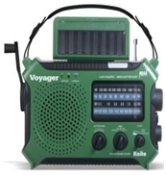
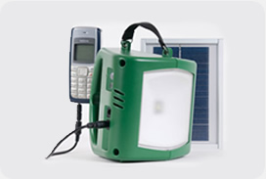
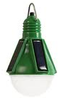
Solar products sold by microfranchisees
TecAp set up a system for microfranchisees to sell solar powered items like lanterns, flashlights, radios and mobile phone chargers.

Slide 8
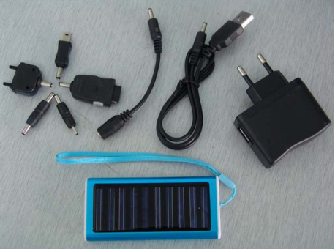
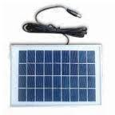
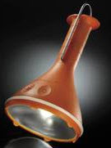
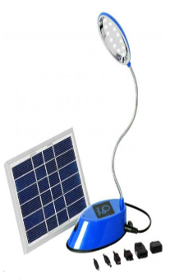
Solar products sold by microfranchisees
TecAp set up a system for microfranchisees to sell solar powered items like lanterns, flashlights, radios and mobile phone chargers.

Slide 9
How are the microfranchisees selected?
Potential candidates are nominated by the head of the gender committee of the cooperative.
Candidates are reviewed by the cooperative’s board of directors and selected based on:
leadership experience
community influence
sales experience
experience managing money
Nominees are reviewed by TecAp staff and invited to an orientation
Women who become active microfranchisees are then eligible for membership in the cooperative, which affords them the right to vote and increases women’s representation in a traditionally male-dominated organization.

Slide 10
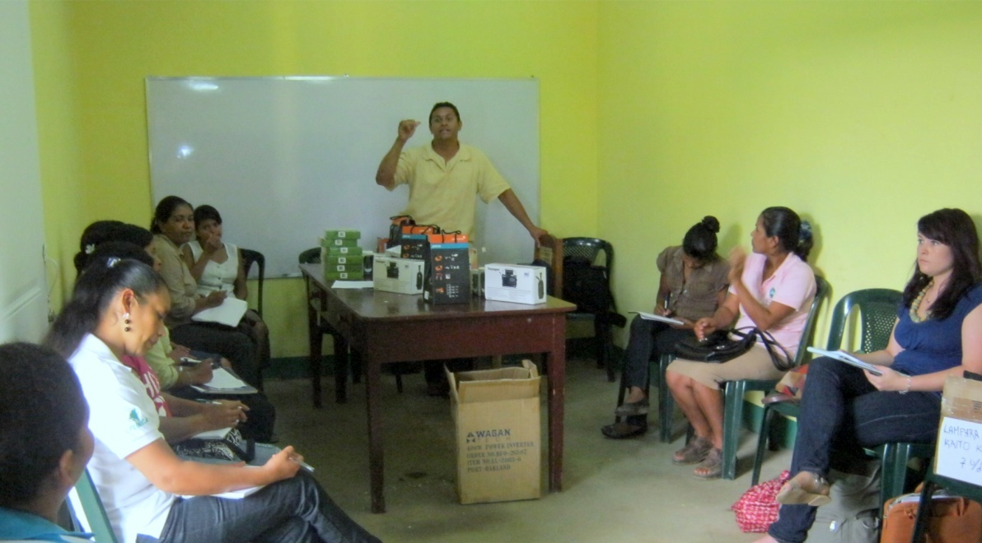
Microfranchisees meet once a month for training & logistics
TecAp meets with the microfranchisees once a month to:
review how sales have gone
discuss customer concerns
give answers to questions
seek ways to improve the system

Slide 11
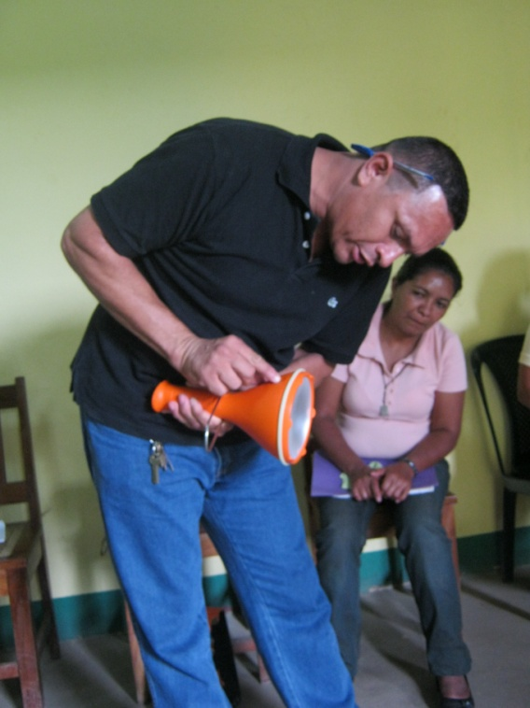
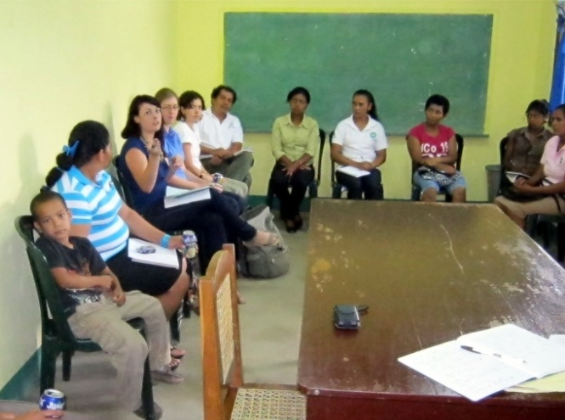
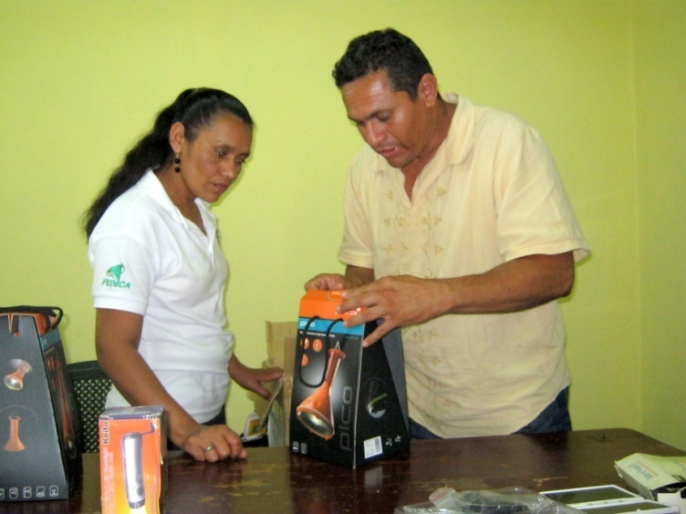
Microfranchisees meet once a month for training & logistics
Much of the meeting is dedicated to TecAp training the women about new items and deepening their understanding about technology. Most have an elementary education.

Slide 12
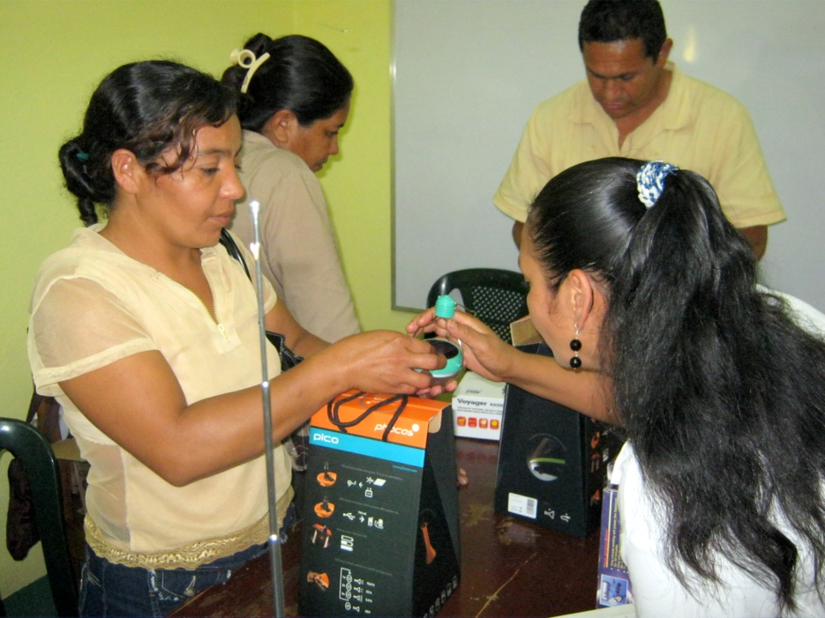
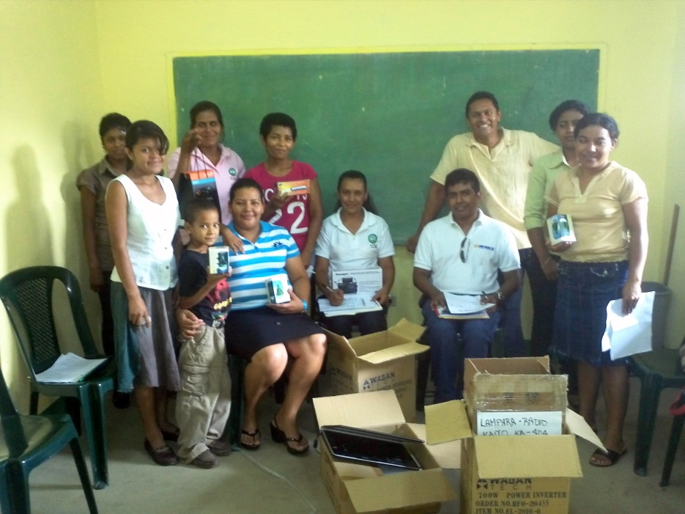
Microfranchisees meet once a month for training & logistics
The microfranchisees receive the items that have been ordered. And the cycle begins again.

Slide 13
The TecAp Microfranchisor provides:
A proven business plan
The brand, marketing techniques & publicity
Useful products at low prices, due to buying at wholesale, bringing to microfranchisees economies of scale
Products that the competition does not have
A monopoly territory in which to sell
Training and ongoing technical assistance in monthly sessions
The Microfranchisee is a low-income woman micro-entrepreneur that learns how to operate the business and how to grow the business quickly, because of the advantages of being part of the TecAp microfranchise.
The TecAp Microfranchise System
IDEAS is both a US & Nicaraguan non-profit that is the Microfranchisor, which the owner of the TecAp trade mark & the microfranchise. The TecAp microfranchise is a proven business model that has been systematized in order to be repeated in many places by independent women microentrepreneurs in Central America.
A Microfinance institution lends to the microfranchisees to buy products. The microfranchisee becomes profitable faster (than a normal microenterprise) and thus can borrow more money. The risk to the financial institutions is less since it is lending to many who run the exact same business & it receives info on sales volume from the microfranchisor.
The microfranchisee provides: market research, useful experiences & advice to the microfranchisor, in addition to a good sales volume in different products.

Slide 14
What does the TecAp microfranchise provide to these women?
A business that is easily replicable by low income microfranchisees with little formal education
A tested business that meets a market demand at prices her neighbors are willing to pay
Guaranteed margin to the microfranchisees
Assists the women to become credit worthy with an MFI so can later borrow for other purposes.
Rapid growth in numbers of microfranchisees, each of which has her own territory.
Income to the microfranchisor that will eventually have a sustainable business.

Slide 15
What’s next for the microfranchisee program?
During 2012 we hope to grow to 300 franchisees and then to double that to 600 microfranchisees by the end of 2013.
We are expanding the product offering to include still smaller, more affordable solar systems for homes (5W, 10W, and 15W options for families living in extreme poverty).
We are training microfranchisees to sell irrigation systems, rain water catchment systems, and other technologies aside from solar panels for homes and small solar-powered items.

Slide 16
TecAp promotes technologies that are appropriate to rural communities:
Solar technologies
More efficient cook stoves
Rain water catchment systems
Drip irrigation systems

Slide 17
TecAp also arranges financing
Help coops get longer term international financing
Coops then provide microcredit to their members for 3 to 5 years, which lowers the annual amount to be paid and puts larger technologies within reach for low income farmers.

Slide 18
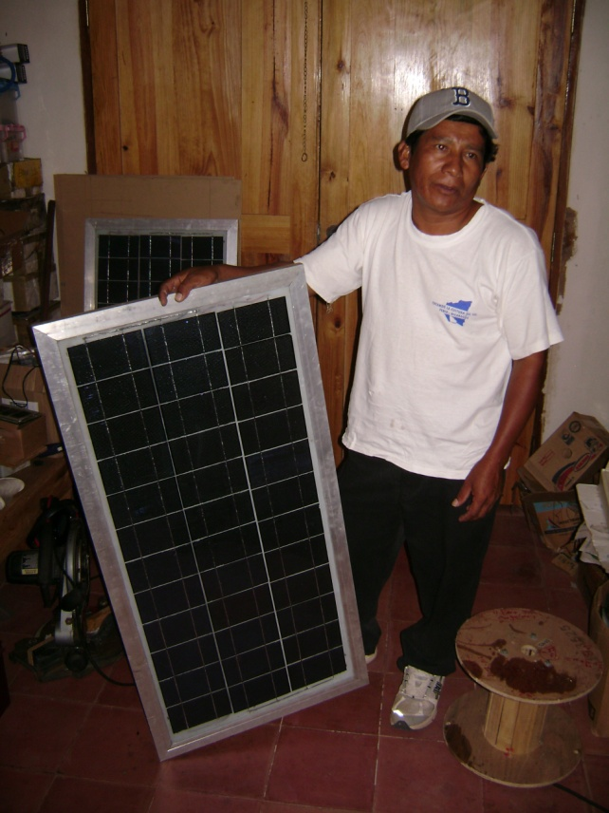
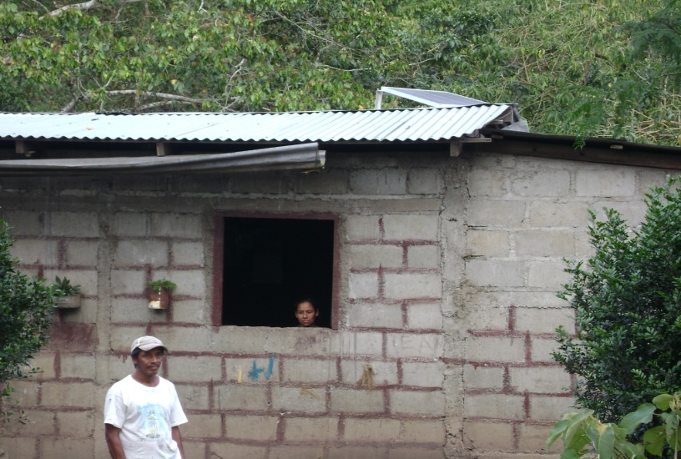
We install Solar Panels in Rural Homes
More than 35% of Nicaraguans are not connected to the electrical power grid
Realistically, the power grid will never reach remote areas
Some areas will get connected for another 15 to 20 years

Slide 19
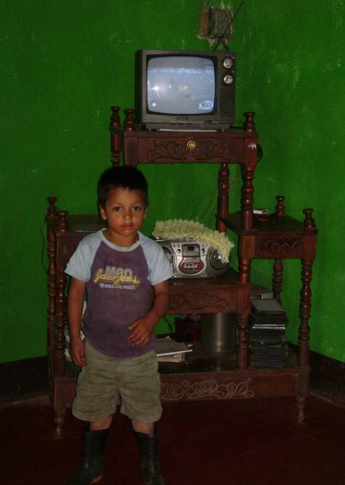
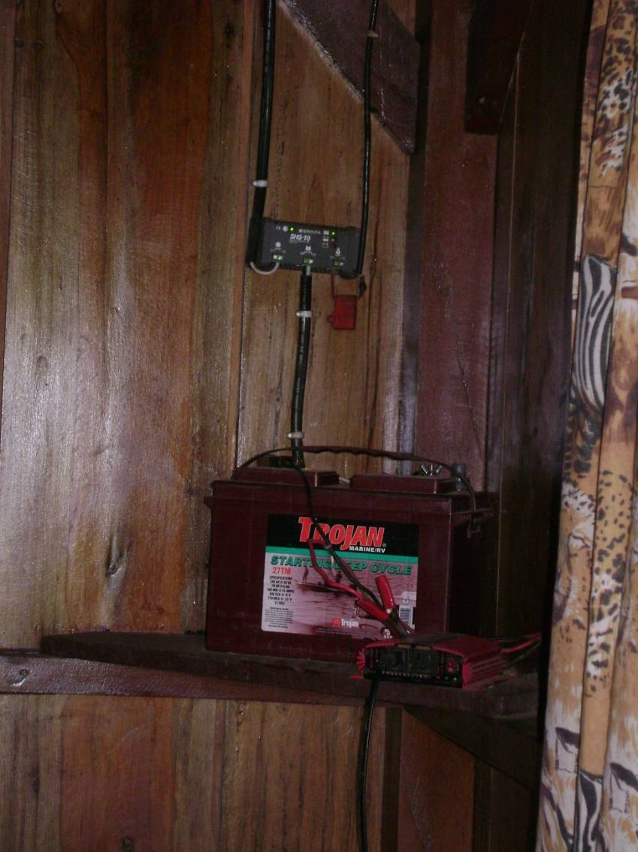
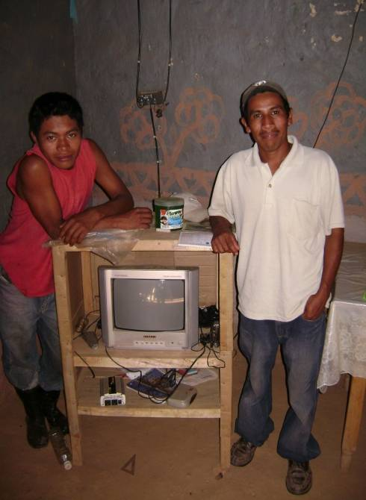
A small photovoltaic system of 85 watts costs about $900.
Provides energy for 6 light bulbs, TV, charging cell phones, appliances, etc.
A 30 watts provide power for 3 light bulbs & AC functionscost about $500.

Slide 20
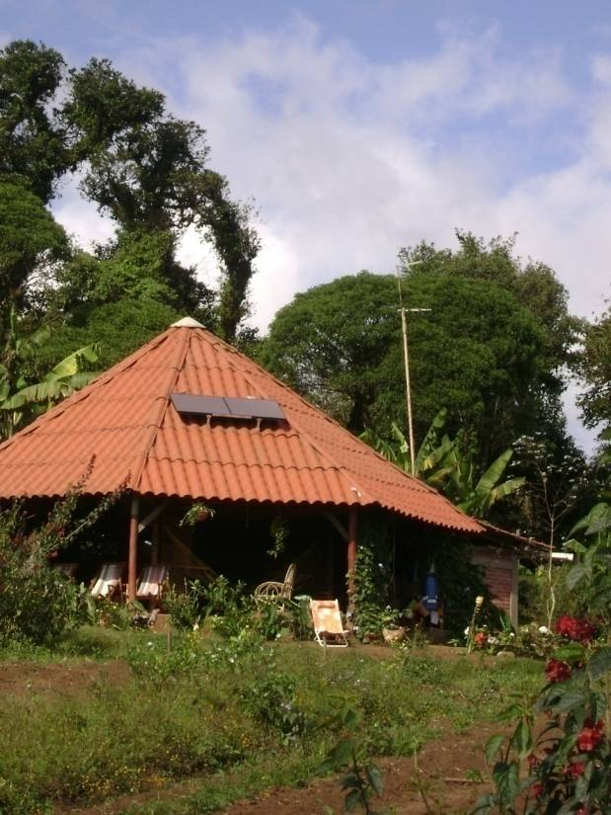
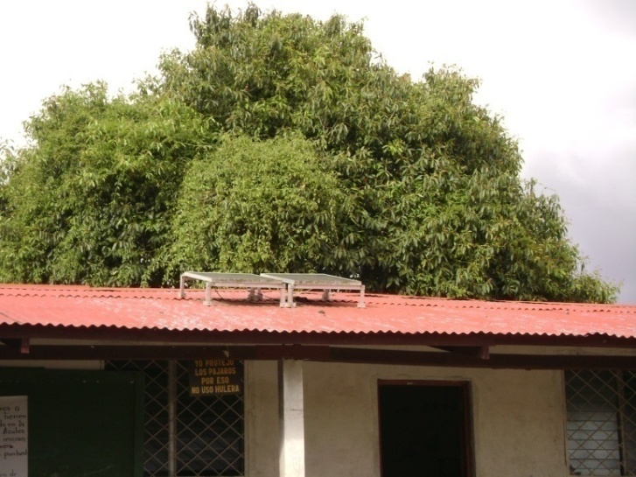
Solar Powers Community Buildings
Ecotourism lounge

Slide 21
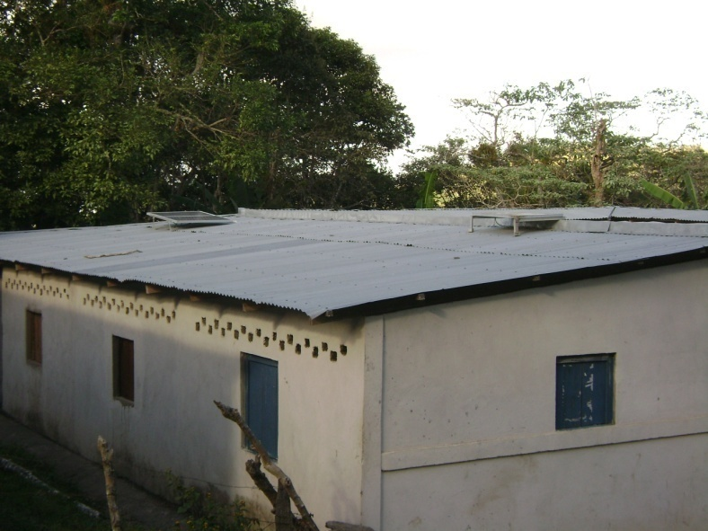
Solar Power for Clinics
This Clinic uses 2 panels:
Panel 1: for the clinic computer, printer, fans, & lights.
Panel 2: for the fridge
Small refrigerator to keep vaccination medicines cool & fresh

Slide 22
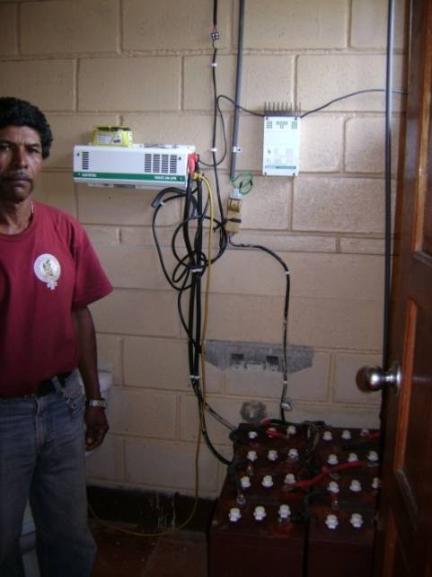
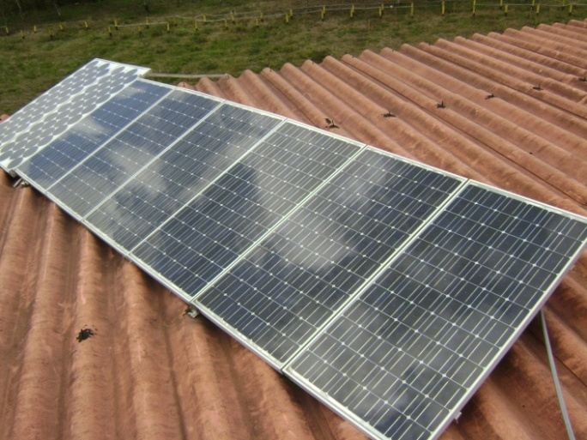
Solar Power for Community Radio Station
Panels on top of radio station
Radio studio with computer, fan, etc.
Batteries store DC power and inverter converts to AC power

Slide 23
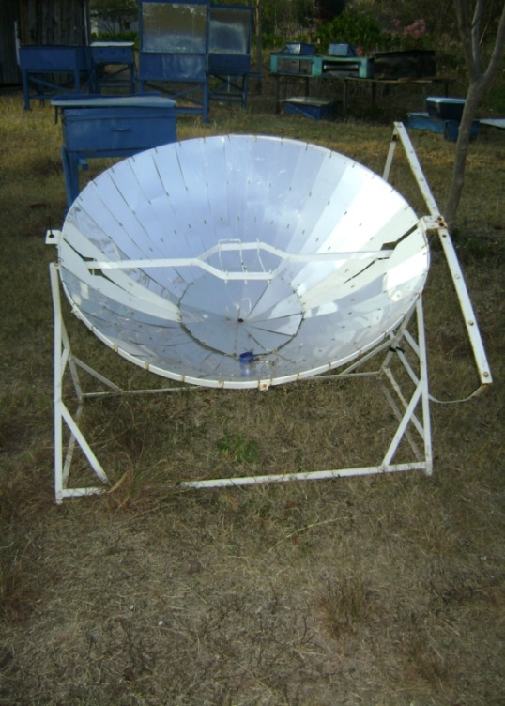
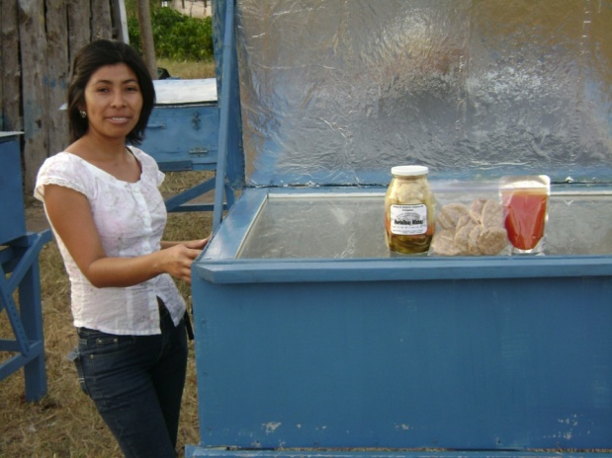
Solar-powered stoves and ovens
Prevent smoke inhalation and lung diseases
Prevent devastating deforestation
Prevent house fires
A women’s cooperative constructs the various stoves using all local materials. They also bake and jar items for sale.

Slide 24
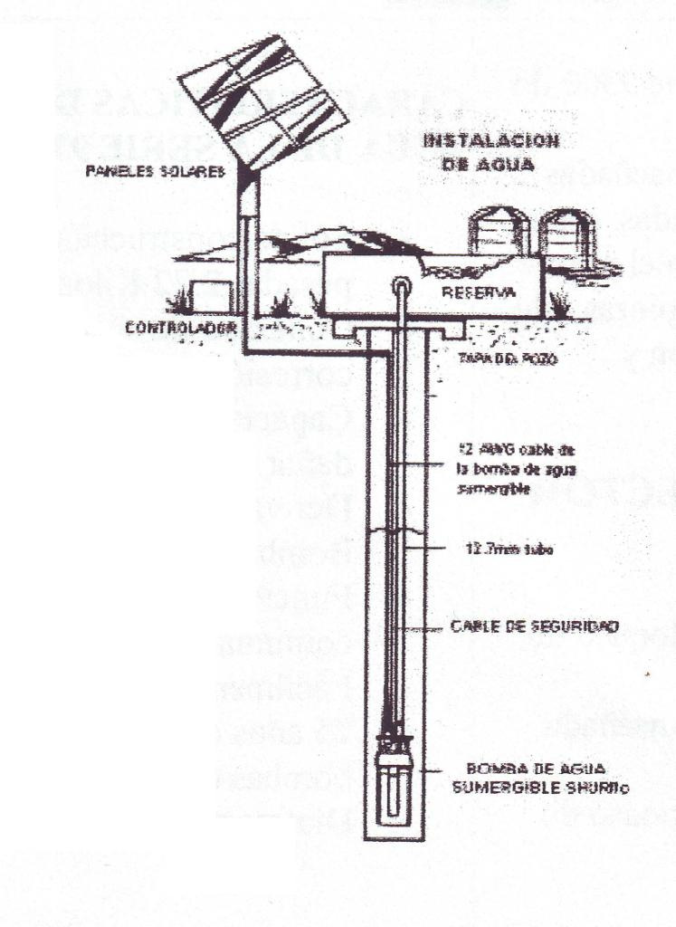
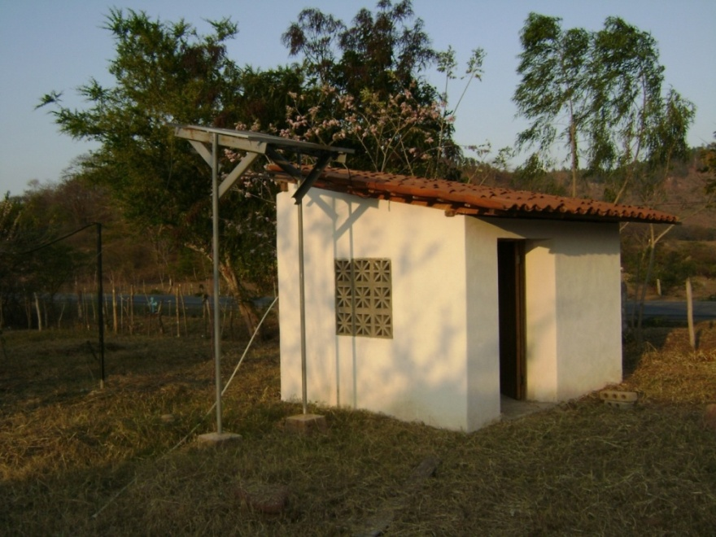
Water Pumping
Solar energy pumps water for homes, animals or irrigation.

Slide 25
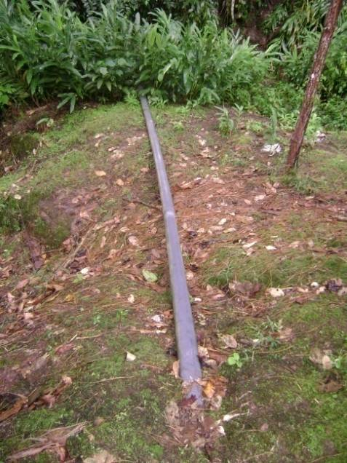
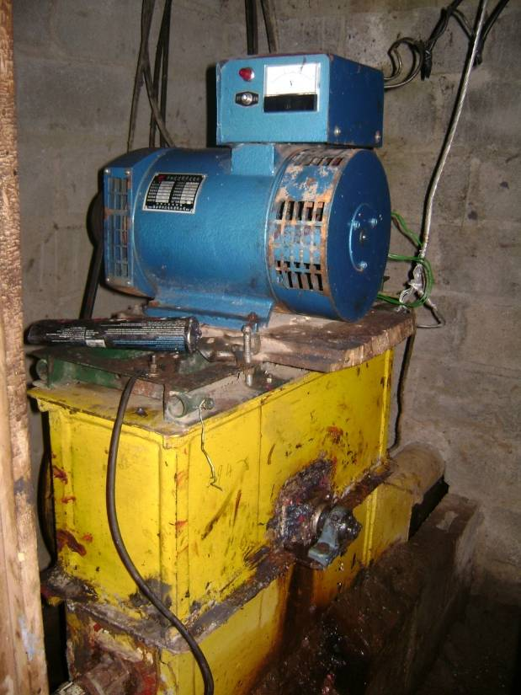
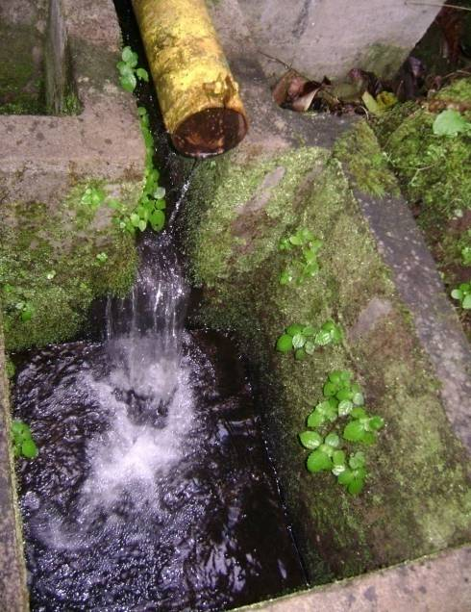
Water Pumping (cont…)
Water coming in
Hydroelectric System
Water returning to stream
25

Slide 26
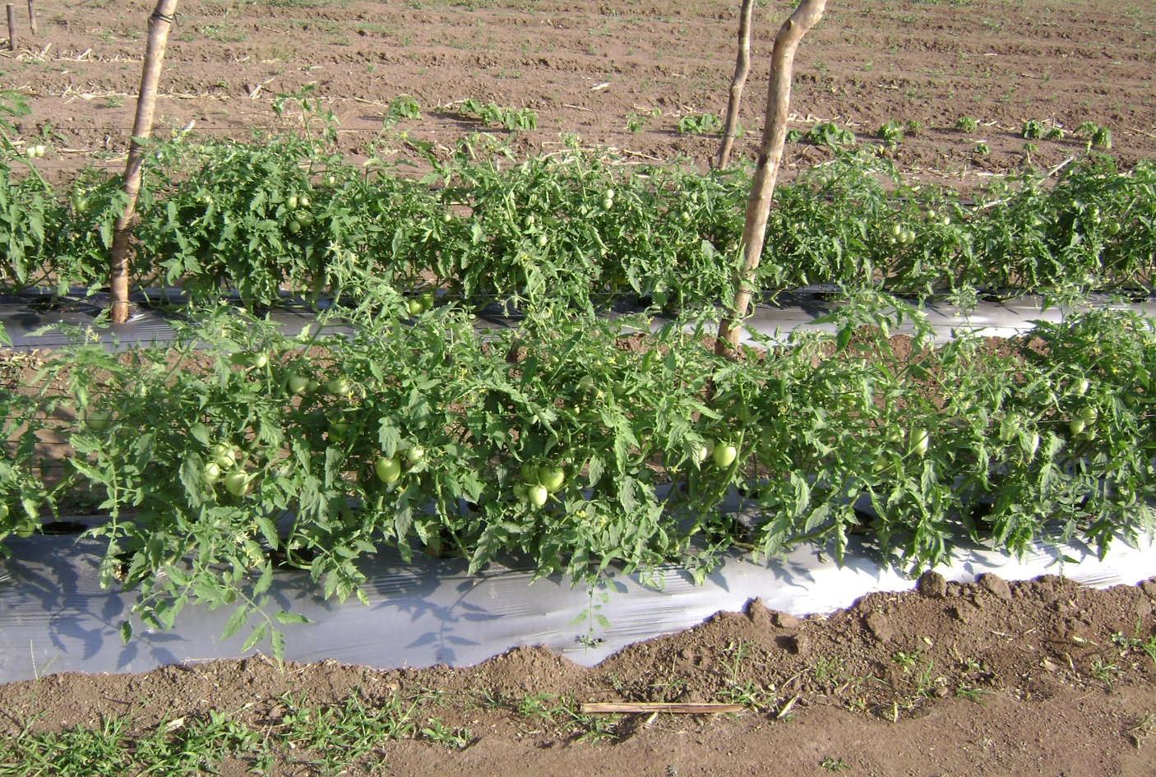
Drip Irrigation
Solar pumps can be connected to drip irrigation that conserves water.

Slide 27
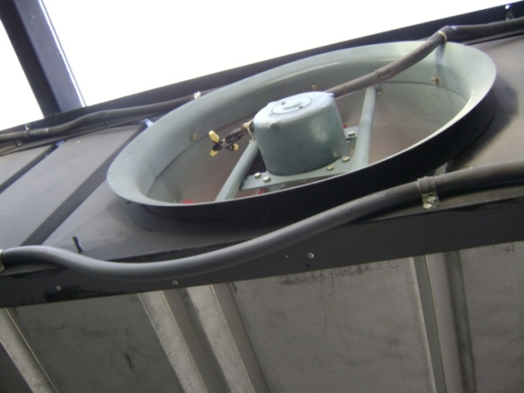
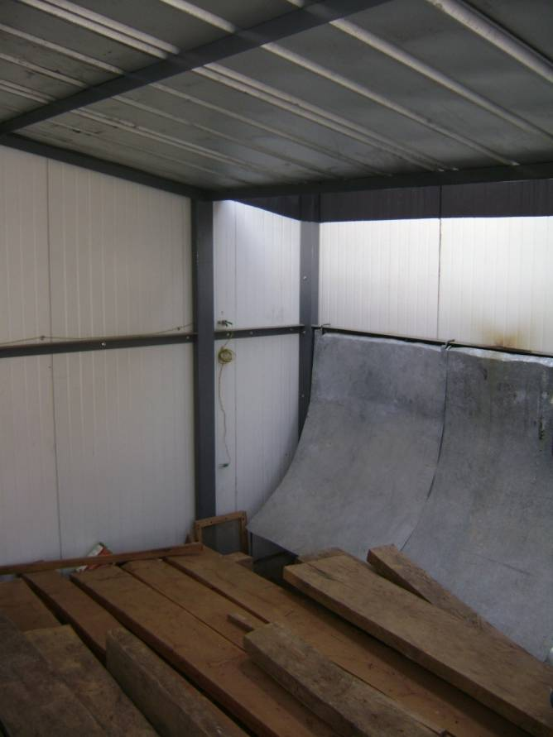
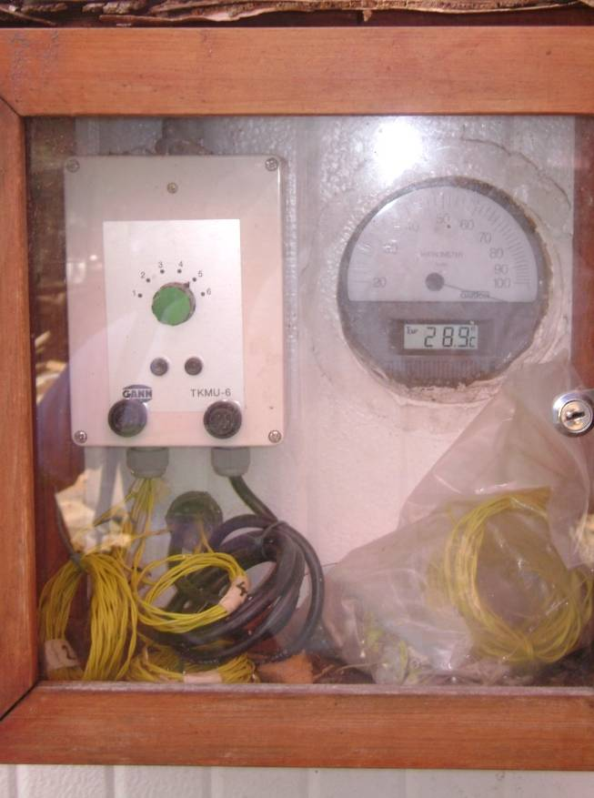
Solar powered wood dryer makes furniture

Slide 28
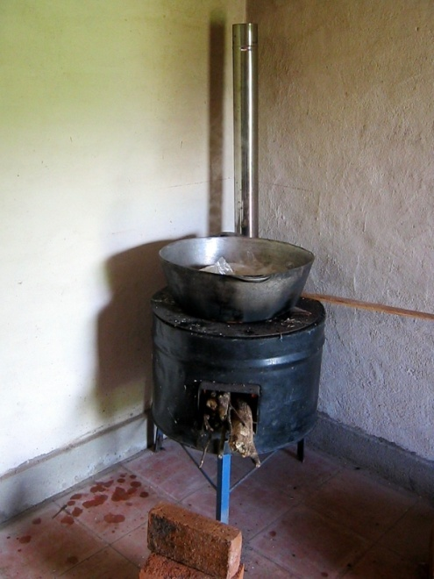
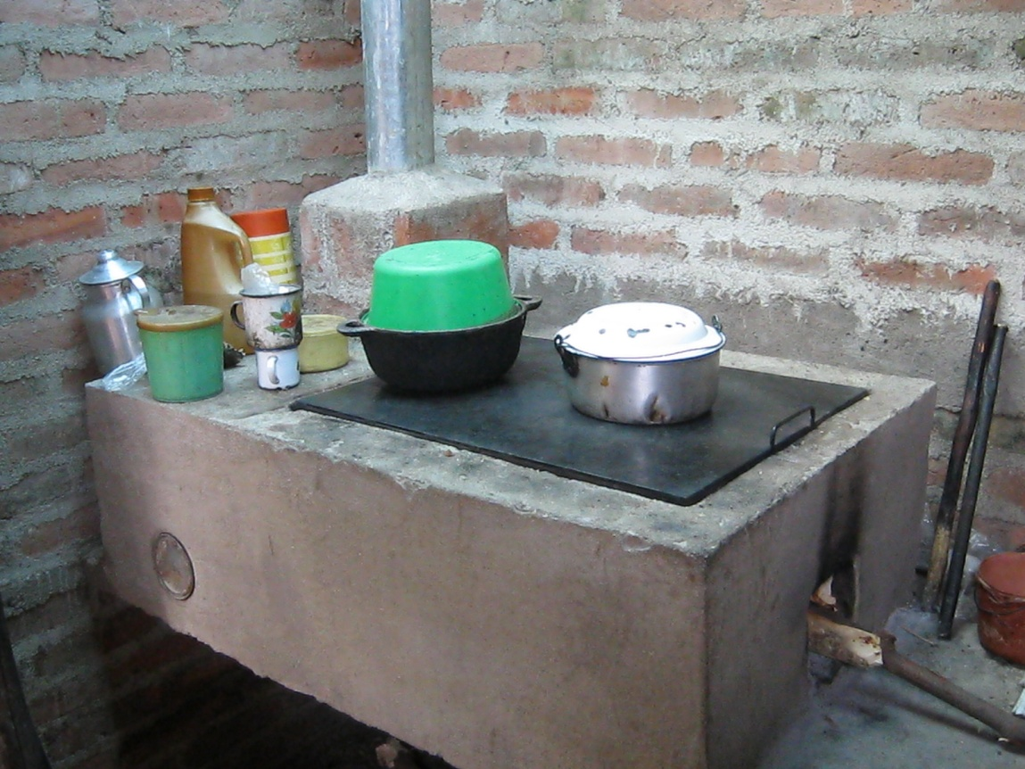
Safer, more efficient cookstoves
Consume 80% less fire wood &
Eliminate smoke through a chimney
Between 1990 and 2010, Nicaragua lost 31.0% of its forest cover.

Slide 29
IDEAS’ recent activities in microfranchise development
A course at the American University in Nicaragua (UAM) as a part of the Masters in Microfinance
A presentation at the Regional Conference on MFIs in Central America (REDCAMIF Network)
Extensive research terminating in a 100-page study on the Potential for Microfranchising in Nicaragua. Done for UAM and the Chamber of Commerce, paid for by Inter-American Development Bank FOMIN
Conference and a workshop for the National Commission for Micro and Small Enterprises (CONAMYPE) in El Salvador. Ongoing advice leading to a program.
Research in Guatemala with members of REDIMIF

Slide 30
Please Get Involved with TecAp & IDEAS
DONATE
Support the start-up of a new group of microfranchisees
Support rural youth being trained to be “micro-technicians” to install & repair solar systems
Support the installation of large-scale tech investments (solar, wind, and hydro power projects) at coffee cooperatives & elsewhere
INVEST
Become a socially responsible investor in TecAp. Lend to our loan fund!
VOLUNTEER
On the internet, from the comfort of your own home OR
In-country

Slide 31
FOR MORE INFORMATION ON MICROFRANCHISING DEVELOPMENT SERVICES BY IDEAS
International— International Executive Director
Dr. Carter Garber cgarber@ideasnet.org
Phone in USA: (404)378-7544 Fax: (404) 378-9322
Latin America—Regional Representative
Gabriel Gaitan in Nicaragua ggaitan@ideasnet.org
Phone in Nicaragua: (505) 2233-5301 o 8985-7342
IDEAS has worked with development agencies and MFIs in Latin America, the Caribbean, Africa, Asia, and North America and is well known for providing high-quality training and consulting services. We provide turn-key solutions.

